Slide 1
CSCI 561 Foundations of Artificial Intelligence Lecture 9-10: Propositional Logic (Chapter 7)
FALL 2018
Instructor:
Prof. Sheila Tejada
cs561-l@mymaillists.usc.edu

Slide 2
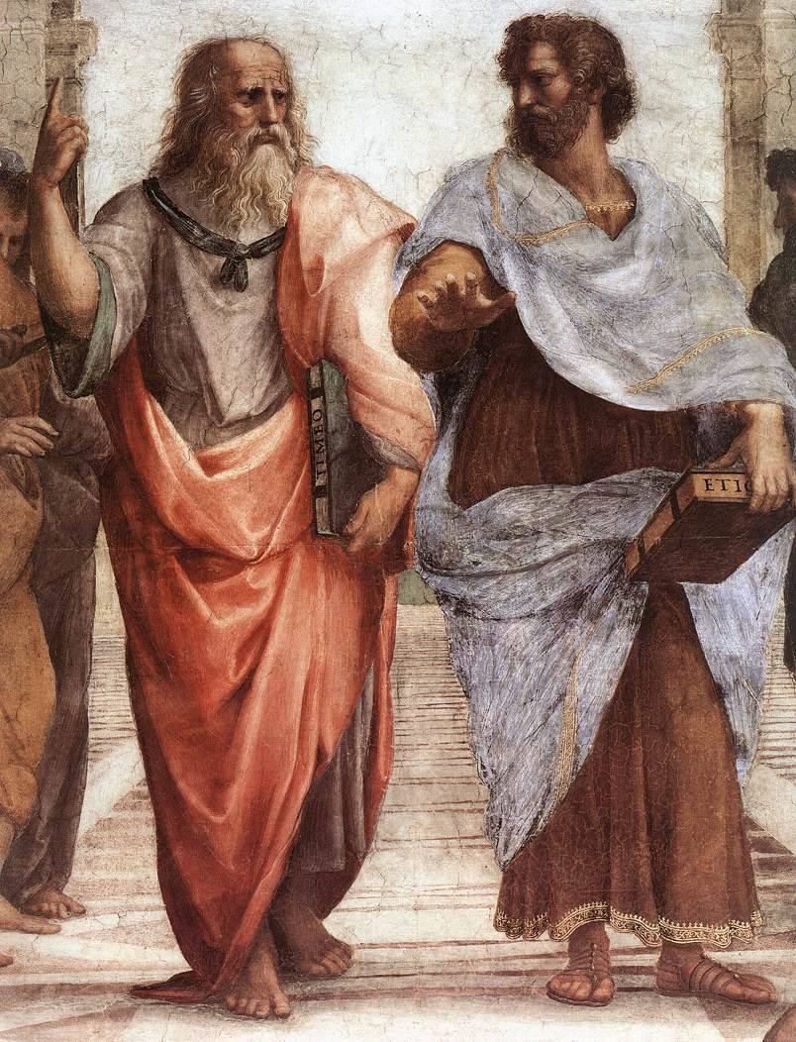
Syllogisms of Aristotle
All men are mortal. All Greeks are men. ∴ All Greeks are mortal.
No reptiles have fur. All snakes are reptiles. ∴ No snakes have fur.
No flowers are animals. All flowers are plants. ∴ Some plants are not animals.
Plato (left) and Aristotle (right).
“School of Athens” – Raphael.
2

Slide 3
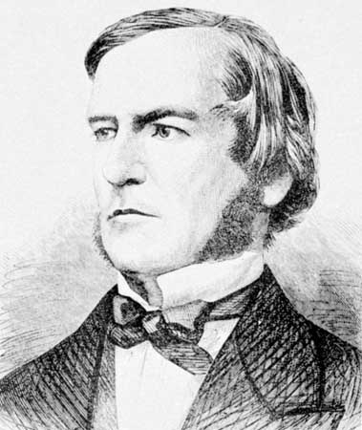
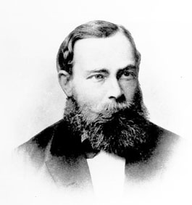
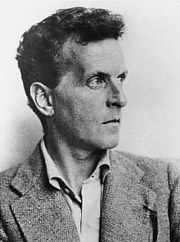
Philosophical foundations
George Boole
Propositional logic, Boolean algebra
The Laws of Thought (1854)
Gottlob Frege
First-order logic,
Formal notation
Begriffsschrift (1879)
Ludwig Wittgenstein
Truth tables,
Logical semantics
Tractatus (1921)
3

Slide 4
Propositional & First-order Logic
Propositional
P ⋀ Q ⇒ R
(¬P⋁¬Q) ⋀ (¬R⋁S)
(P⇒Q) ⋁ (P⇒¬S)
Breeze ⋀ ¬Forward
First-order
∃x . red(x) ⋀ line(x)
∀x . greek(x) ⇒ mortal(x)
∀x∃y . r(x,y)
∀x,y,z . r(x,y) ⇒ s(F₁(x),z)
4

Slide 5
Knowledge-Based Agent
Domain independent
algorithms
Agent that uses prior or acquired knowledge to achieve its goals
Can make informed decisions
Can make more efficient decisions
Knowledge Base (KB): contains a set of representations of facts about the Agent’s environment.
Each representation is called a sentence.
Use knowledge representation language, to TELL the agent what to know, e.g., (temperature 72F)
Query what to do by ASK-ing the agent.
Agent can use inference to deduce new facts from TELL-ed facts.
ASK
Inference engine
TELL
Knowledge Base
(Sentence 1,
Sentence 2,
Sentence 3.
…)
Domain specific content
Syntax: how sentences are expressed.
Semantics: meaning of the sentence, e.g., truth value.
5

Slide 6
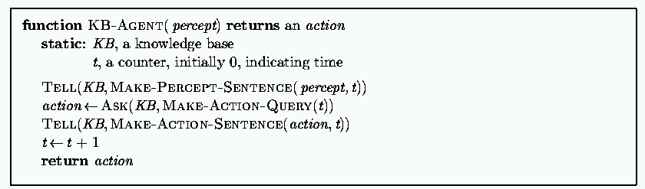
Generic knowledge-based agent
TELL KB what was perceived Uses a KRL to insert new sentences, representations of facts, into KB
ASK KB what to do. Uses logical reasoning to examine actions and select best.
6

Slide 7
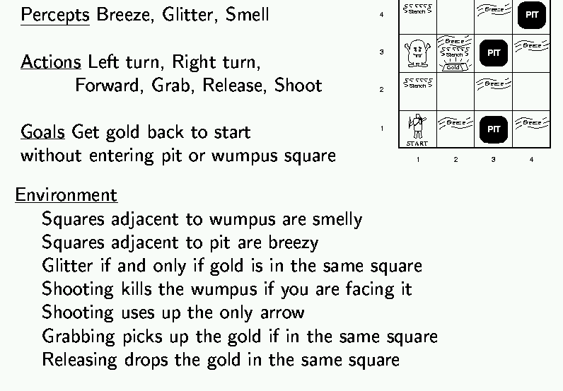

Wumpus World Example
7

Slide 8
Wumpus World Characterization
Fully Observable?
Deterministic?
Static?
Episodic?
Discrete?
Single Agent?
8

Slide 9
Wumpus World Characterization
Fully Observable? No – only local observations.
Deterministic? Yes – outcome exactly specified.
Static? Yes – Wumpus and pits do not move.
Episodic? No – sequence of action to get reward.
Discrete? Yes.
Single Agent? Yes.
9

Slide 10
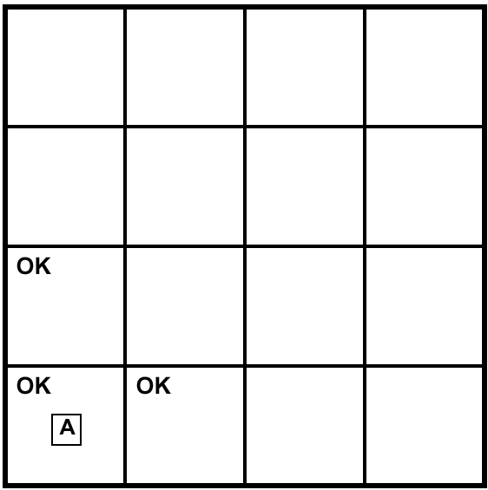
Exploring a Wumpus World
A = Agent
B = Breeze
S = Smell
P = Pit
W = Wumpus
OK = Safe
V = Visited
G = Glitter
10

Slide 11
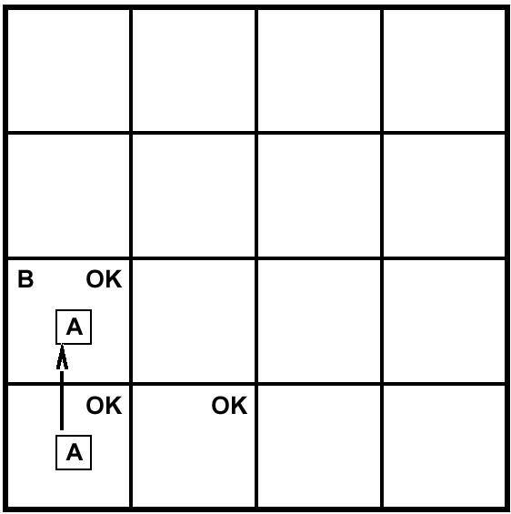
Exploring a Wumpus World
A = Agent
B = Breeze
S = Smell
P = Pit
W = Wumpus
OK = Safe
V = Visited
G = Glitter
11

Slide 12
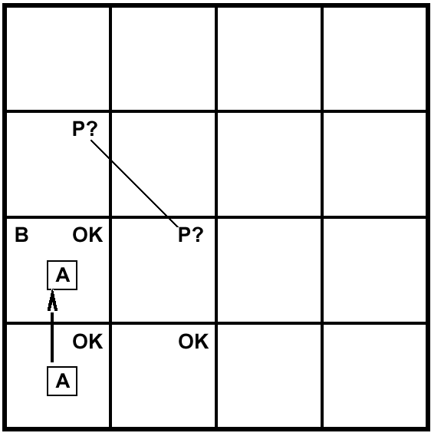
Exploring a Wumpus World
A = Agent
B = Breeze
S = Smell
P = Pit
W = Wumpus
OK = Safe
V = Visited
G = Glitter
12

Slide 13
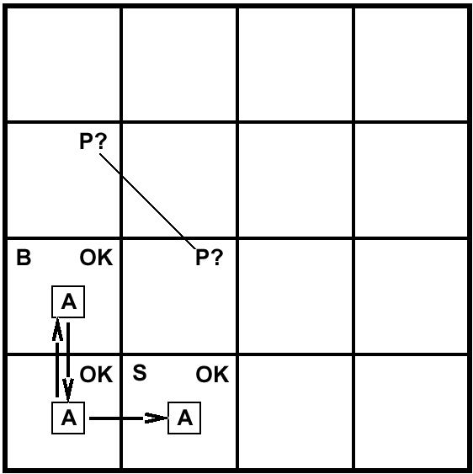
Exploring a Wumpus World
A = Agent
B = Breeze
S = Smell
P = Pit
W = Wumpus
OK = Safe
V = Visited
G = Glitter
13

Slide 14
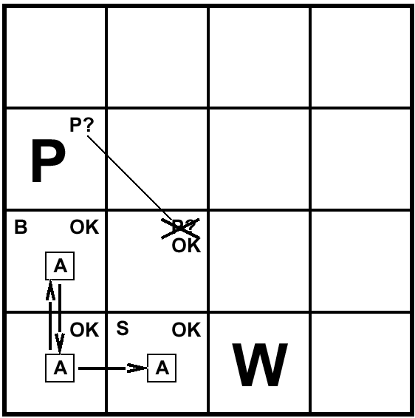
Exploring a Wumpus World
A = Agent
B = Breeze
S = Smell
P = Pit
W = Wumpus
OK = Safe
V = Visited
G = Glitter
14

Slide 15

Exploring a Wumpus World
A = Agent
B = Breeze
S = Smell
P = Pit
W = Wumpus
OK = Safe
V = Visited
G = Glitter
15

Slide 16
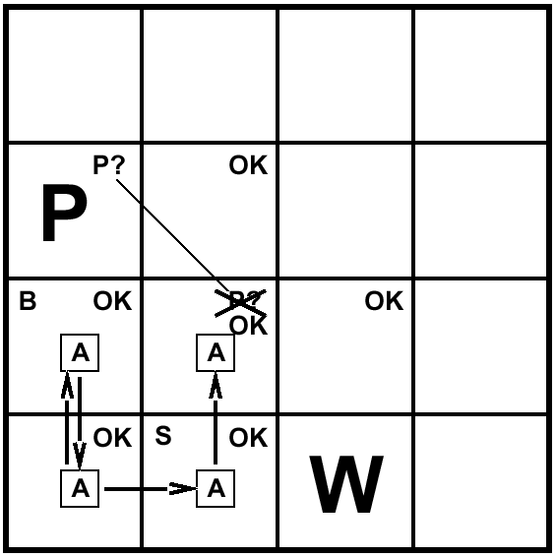
Exploring a Wumpus World
A = Agent
B = Breeze
S = Smell
P = Pit
W = Wumpus
OK = Safe
V = Visited
G = Glitter
16

Slide 17
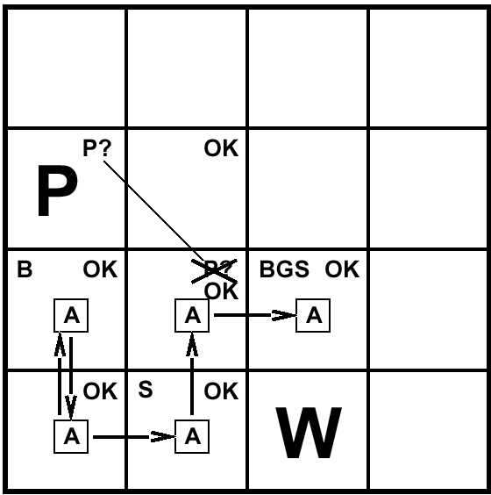
Exploring a Wumpus World
A = Agent
B = Breeze
S = Smell
P = Pit
W = Wumpus
OK = Safe
V = Visited
G = Glitter
17

Slide 18
Other tight spots
18

Slide 19
Another example solution
No perception → (1,2) and (2,1) OK
Move to (2,1)
B in (2,1) → (2,2) or (3,1) has P
(1,1) is V → no P in (1,1)
Move to (1,2), the only safe unvisited option
19

Slide 20
Another example solution
S in (1,2) and (1,1) V → (1,3) or (2,2) has W
No S when in (2,1) → (1,3) has W
No B in (1,2) → (2,2) is OK and (3,1) has P
Move to (2,2), the only safe unvisited option
No perception in (2,2) → (2,3) and (3,3) OK
Move to (2,3), perceive S, G & B
…
20

Slide 21
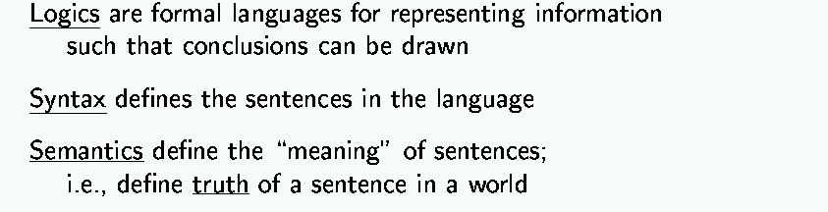
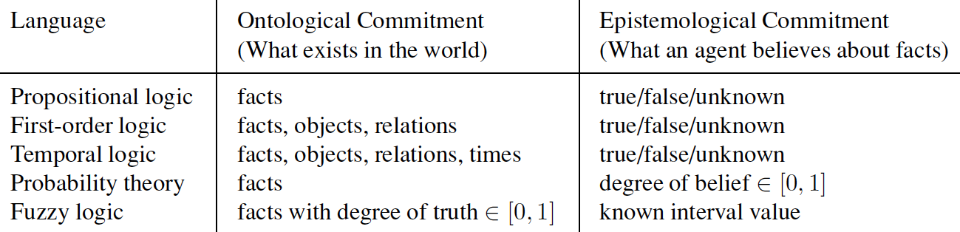
Logic
Types of Logic
21

Slide 22
Logic as a Representation of the World
Representation Sentences
Entails
Sentence
Semantics
Semantics
Follows
World
Facts
Fact
22

Slide 23
Models
Logicians think world as models, represented as m
Formally structured worlds with respect to which truth can be evaluated.
Think of a model as a “possible world”, or…
as a particular truth assignment of the symbols in the sentences
If a sentence α is true in model m, we say m satisfies α, or m is a model of α.
M(α) is the set of all models of α
M(KB) is the set of all models of KB
KB ⊨ α if and only if M(KB) is a subset M(α)
x
x
M(KB)
x
x
x
x
x
x
x
x
x
x
x
x
x
x
x
x
x
x
x
x
x
x
x
x
x
x
M(α)
x
x
x
x
x
x
23

Slide 24
Entailment
M(α)
M(KB)
KB ⊨ α: KB entails sentence α, if and only if, α is true in all worlds where KB is true.
E.g., the KB contains “USC won” and “UCLA won”, entails “Either USC or UCLA won”
x
x
x
x
x
x
x
x
x
x
x
x
x
x
x
x
x
x
x
x
x
x
x
x
x
x
x
x
x
x
x
x
x
x
- Entailment means it is impossible that premises are true and the consequence is false.
- Entailment (⊨) is different from inference (⊢).
Think of inference a the process of finding the entailment.
24

Slide 25
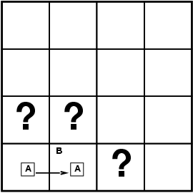
Entailment in Wumpus World
Situation after detecting nothing in [1,1], moving right, breeze in [2,1]
KB = Wumpus-World rules + Observations (nothing in [1,1], B in [2,1])
Consider possible models for KB assuming only Pits
3 Boolean choices ⇒ 8 possible models, e.g.,
Model 1: P in [1,2], P in [2,2], P in [3,1]
Model 2: P in [1,2], no P in [2,2], P in [3,1]
Model 3: P in [1,2], P in [2,2], no P in [3,1]
Model 4: P in [1,2], no P in [2,2], no P in [3,1]
…
25

Slide 26
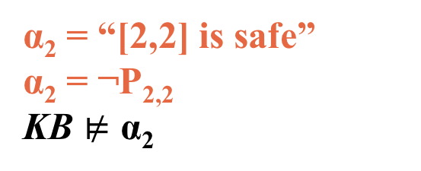
Entailment in Wumpus World
α₁ = “[1,2] is safe”
α₁ = ¬P_{2,1}
KB ⊨ α₁
α₂ = “[2,2] is safe”
α₂ = ¬P_{2,2}
KB $⊭$ α₂
Model Checking: an inference algorithm to prove entailment by enumerating through all possible models to check if α is true in all models where KB is true.
26

Slide 27

Inference
KB ├_{i} α = sentence α can be derived from KB by procedure i
Soundness: i is sound if whenever KB ├_{i} α, it is also true that KB╞ α. (Think of it as whenever the inference procedure finds α, it guarantees that KB indeed entails α.)
Completeness: i is complete if whenever KB╞ α, it is also true that KB ├_{i} α. (Think of it as finding any the sentence α that is entailed by KB.)
Entailment and Inference
To understand╞ and├, think of all consequences of a KB as a haystack and of α as a needle.
Entailment is like the needle being in the haystack;
Inference is like finding it.
27

Slide 28

Propositional Logic: Symbols
Boolean variables, either true or false
P, Q, R
Forward, Tuesday, Raining
MoonIsMadeOfCheese
W_{2,3}
Two special symbols:
True (also written as ⊤ or 1)
False (also written as ⊥ or 0)
28

Slide 29

Propositional Logic: Sentences
Statements that evaluate to either true or false
Atomic sentences
A single proposition symbol
W_{2,3}
MoonIsMadeOfCheese
Complex sentences
One or more propositions with logical connectives
P ⋀ Q ⇒ R
(¬P ⋁ ¬Q) ⋀ (¬R ⋁ S)
29

Slide 30
Propositional Logic: Literal
An atomic sentence or its negation.
Positive literal
P, Q, P, W_{2,3}, MoonIsMadeOfCheese
Negative literal
¬P, ¬W_{2,3}, ¬MoonIsMadeOfCheese
For example, the sentence (¬P ⋁ ¬Q) ⋀ (¬R ⋁ S)
contains 4 literals: ¬P, ¬Q, ¬R and S
30

Slide 31
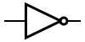
Not ¬
Inverts the truth value of a proposition symbol or sentence.
Analogous to a minus sign in arithmetic.
Negation of proposition symbols
¬P, ¬W_{2,3}, ¬MoonIsMadeOfCheese
Negation of other sentences
¬(P ⋀ Q ⇒ R)
31

Slide 32
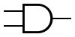
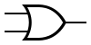
And ⋀
Evaluates to True only when both sides are True.
Conjunction: A sentence whose main connective is ⋀
P ⋀ Q ⋀ R is a conjunction of three conjuncts
(P ⋀ Q) ⋀ (R ⋀ S) ⋀ (T ⋀ U) also a conjunction of three conjuncts
Or ⋁
Evaluates to True when one or more sides is True.
Disjunction: A sentence whose main connective is ⋁
P ⋁ Q ⋁ R is a disjunction of three disjuncts
(P ⋀ Q) ⋁ (R ⋀ S) ⋁ (T ⋀ U) also a disjunction of three disjuncts
32

Slide 33
Implies ⇒
Antecedent: The sentence on the left-hand side of the ⇒
Consequent: The sentence on the right-hand side of the ⇒
antecedent ⇒ consequent
Evaluates to True except when the antecedent is True and the consequent is False.
Examples:
Raining ⇒ SidewalkIsWet
Tuesday ⋁ Wednesday ⋁ Monday ⇒ CS561Lecture
CS561Instructors ⇒ Shen ⋁ Tejada
33

Slide 34
Biconditional ⟺
Evaluates to True when both sides are True or both sides are False
In English, one would say “if and only if”, e.g. when making a definition.
Henry is Indiana’s father. ⟺ Indiana is Henry’s son.
Equivalent to a conjunction of two implications.
(Henry is Indiana’s father. ⇒ Indiana is Henry’s son.) ⋀
(Indiana is Henry’s son. ⇒ Henry is Indiana’s father.)
34

Slide 35
Propositional Logic: Logic Connectives Summary
Expressions only evaluate to either “true” or “false.”
P “P is true”
¬P “P is false” negation
P ⋀ Q “both P and Q are true” conjunction
P ⋁ Q “either P is true or Q is true or both” disjunction
P ⇒ Q “if P is true, then Q is true” implication
P ⬄ Q “P and Q are either both true or both false” equivalence
35

Slide 36
Propositional Logic: Syntax
Propositional logic is the simplest logic – illustrates basic ideas
The proposition symbols P₁, P₂ etc are sentences
If S is a sentence, ¬S is a sentence (negation)
If S₁ and S₂ are sentences, S₁ ∧ S₂ is a sentence (conjunction)
If S₁ and S₂ are sentences, S₁ ∨ S₂ is a sentence (disjunction)
If S₁ and S₂ are sentences, S₁ ⇒ S₂ is a sentence (implication)
If S₁ and S₂ are sentences, S₁ ⇔ S₂ is a sentence (biconditional)
36

Slide 37
Propositional Logic: Semantics
Each model specifies true/false for each proposition symbol
E.g. P_{1,2} P_{2,2} P_{3,1}
false true false
Rules for evaluating truth with respect to a model m:
¬S is true iff S is false
S₁ ∧ S₂ is true iff S₁ is true and S₂ is true
S₁ ∨ S₂ is true iff S₁is true or S₂ is true
S₁ ⇒ S₂ is true iff S₁ is false or S₂ is true
i.e., is false iff S₁ is true and S₂ is false
S₁ ⇔ S₂ is true iff S₁⇒S₂ is true and S₂⇒S₁ is true
37

Slide 38
Truth tables
Rules can be expressed with truth tables.
A lookup table to determine the truth value of a sentence.
Columns: One for each propositional symbol, One for the sentence.
Rows: Enumerated possible truth values of each propositional symbol
Model: A single row in this table.
P | Q | P ⋁ Q
True | True | True
True | False | True
False | True | True
False | False | False
38

Slide 39
Truth table for basic logic connectives
P | Q | ¬P | P ⋀ Q | P ⋁ Q | P ⇒ Q | P ⟺ Q
False | False | True | False | False | True | True
False | True | True | False | True | True | False
True | False | False | False | True | False | False
True | True | False | True | True | True | True
39

Slide 40

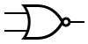
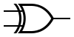

Other logic gates
P | Q | P ⋀ Q | P ⋁ Q | NAND | NOR | XOR | XNOR
False | False | False | False | True | True | False | True
False | True | False | True | True | False | True | False
True | False | False | True | True | False | True | False
True | True | True | True | False | False | False | True
40

Slide 41
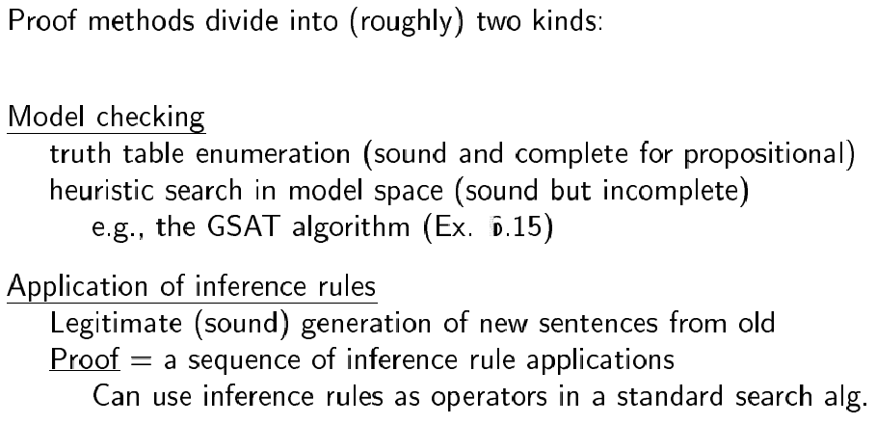
Proof methods
41

Slide 42
Entailment proof with truth table AKA, Proof via model checking, enumeration
To prove a sentence, β
Start with the set of true sentences, the “knowledge base”
Join them all together as one big conjunction, α
Create a truth table for (α ⇒ β)
Verify that this sentence is True in all models.
Algorithm is sound: it directly implements the definition of entailment.
Algorithm is complete: it works for any sentence and always terminates.
However, you need 2^{n} rows, where n is the number of proposition symbols. For sentences with lots of symbols, we need a better approach.
42

Slide 43
Example
Does ((¬P ⋁ Q) ⋀ P) entail Q?
β entails α if and only if, in every model in which β is True, α is also True.
β entails α if and only if, (β ⇒ α) is True in every model.
P | Q | (¬P ⋁ Q) ⋀ P | ((¬P ⋁ Q) ⋀ P) ⇒ Q
False | False | False | True
False | True | False | True
True | False | False | True
True | True | True | True
Yes! ((¬P ⋁ Q) ⋀ P) ⊨ Q
43

Slide 44
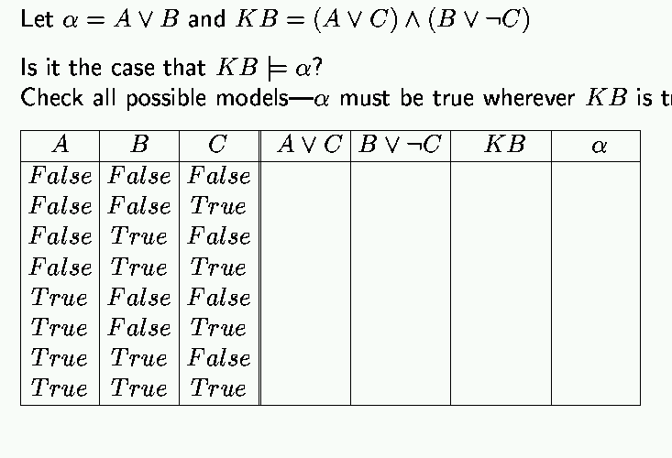
Propositional Inference: Enumeration Method
true
44

Slide 45
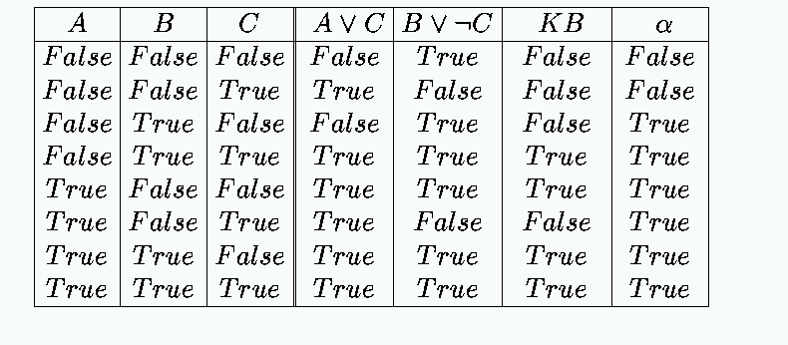
Propositional Inference: Enumeration Solution
✔
true
45

Slide 46
Proof with Enumeration Wumpus World Example
Let P_{i,j} be true if there is a pit in [i, j].
Let B_{i,j} be true if there is a breeze in [i, j].
"Pits cause breezes in adjacent squares"
B_{1,1} ⇔ (P_{1,2} ∨ P_{2,1})
B_{2,1} ⇔ (P_{1,1} ∨ P_{2,2} ∨ P_{3,1})
α₁ = “[1,2] is safe” (α₁ = ¬P_{1,2})
P?
P?
B
B
P?
P?
P?
46

Slide 47
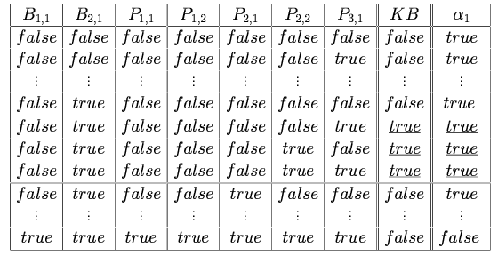
Wumpus World: Truth Tables for Inference
KB ⊨ α₁
47

Slide 48
Proofs using theorem proving
Applying rules of inference directly to the sentences in the KB to construct a proof of the desired sentences without consulting models.
Suitable when the number of models is large but the length of proof is short → Theorem proving can be more efficient than model checking.
Key concepts:
Logical Equivalence
Validity
Satisfiability
48

Slide 49
Logical Equivalence
Two sentences are logically equivalent if they have identical columns a truth table.
Example: Are these two equivalent? P ⇒ Q, ¬P ⋁ Q
Yes! An implication is equivalent to the disjunction of the consequent and the negation of the antecedent (implication elimination)
P | Q | P ⇒ Q | ¬P ⋁ Q
False | False | True | True
False | True | True | True
True | False | False | False
True | True | True | True
49

Slide 50
Validity
A sentence is valid if it is true in all models.
E.g., P ⋁ ¬P is valid.
Valid sentences are Tautologies.
Satisfiability
A sentence is satisfiable if it is true in at least one model
50

Slide 51
Validity and Satisfiability
A sentence is valid if it is true in all models.
A sentence is satisfiable if it is true in at least one model.
α is valid if and only if ¬α is unsatisfiable.
¬α is unsatisfiable →
¬α is false in all models →
α is true in all models →
α is valid
α is satisfiable if and only if ¬α is not valid.
¬α is not valid → ¬α is not true in all models →
at least one model ¬α is false →
at least one model α is true →
α is satisfiable
51

Slide 52
Tautology
A sentence that is necessarily True, in all models (rows of a truth table)
Because P ⇒ Q is equivalent to ¬P ⋁ Q, the following is a tautology:
(P ⇒ Q) ⟺ (¬P ⋁ Q)
It is also a tautology for any pair of sentences, α and β:
(α ⇒ β) ⟺ (¬α ⋁ β)
There are many important tautologies, some with their own special names.
52

Slide 53
Important Tautologies Basic Manipulation Rules for Propositional Logic
α ⋀ β | ⟺ | β ⋀ α | Commutativity of ⋀
α ⋁ β | ⟺ | β ⋁ α | Commutativity of ⋁
(α ⋀ β) ⋀ γ | ⟺ | α ⋀ (β ⋀ γ) | Associativity of ⋀
(α ⋁ β) ⋁ γ | ⟺ | α ⋁ (β ⋁ γ) | Associativity of ⋁
¬(¬α) | ⟺ | α | Double-negation elimination
α ⇒ β | ⟺ | ¬β ⇒ ¬α | Contraposition
α ⇒ β | ⟺ | ¬α ⋁ β | Implication elimination
α ⟺ β | ⟺ | (α ⇒ β) ⋀ (β ⇒ α) | Biconditional elimination
¬(α ⋀ β) | ⟺ | ¬α ⋁ ¬β | De Morgan
¬(α ⋁ β) | ⟺ | ¬α ⋀ ¬β | De Morgan
α ⋀ (β ⋁ γ) | ⟺ | (α ⋀ β) ⋁ (α ⋀ γ) | Distributivity of ⋀ over ⋁
α ⋁ (β ⋀ γ) | ⟺ | (α ⋁ β) ⋀ (α ⋁ γ) | Distributivity of ⋁ over ⋀
53

Slide 54
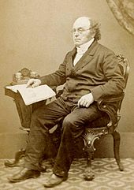
The De Morgan Laws
Interesting because they show how to express either connective ⋀ and ⋁ in terms of the other.
That means that we could “rewrite” any sentence to a logically equivalent one that did not involve the ⋁ connective.
Example:
(P ⋀ Q) ⋁ (R ⋀ S) Given
¬(¬(P ⋀ Q)) ⋁ ¬(¬(R ⋀ S)) Double-negation elimination
¬(¬P ⋁ ¬Q) ⋁ ¬(¬R ⋁ ¬S) De Morgan
Augustus De Morgan (1806-1871)
54

Slide 55
Entailment as satisfiability
M(β)
M(α)
x
x
x
x
x
x
x
x
x
x
x
x
x
x
x
x
x
x
x
x
x
x
x
x
x
x
x
x
x
x
x
x
x
α ⊨ β if and only if the sentence (α ⇒ β) is valid.
(In all the worlds α is true, β must also be true. There is not a case that α is true but β is false.)
(α ⇒ β) is valid if and only if ¬(α ⇒ β) is unsatisfiable.
(α is valid if and only if ¬α is unsatisfiable.)
¬(α ⇒ β) ⟺ (α ⋀ ¬β)
Implication elimination: (α ⇒ β) ⟺ (¬α ⋁ β)
α ⊨ β if and only if the sentence (α ⋀ ¬β) is unsatisfiable.
x
55

Slide 56
Logical inference
The derivation of logical conclusions from premises known or assumed to be true.
Logical proof
A chain of conclusions that leads from premises to the desired goal via logical inference.
56

Slide 57
Some inference rules
α | β | α ⇒ β
False | False | True
False | True | True
True | False | False
True | True | True
Modus ponens
“The way that affirms by affirming”
Modus tollens
“The way that denies by denying”
α ⇒ β, α
β
α ⇒ β, ¬β
¬α
57

Slide 58
Some more inference rules
α | β | α ⋀ β | α ⋁ β
False | False | False | False
False | True | False | True
True | False | False | True
True | True | True | True
And-Elimination
“simplification”
Or-Introduction
“addition”
α ⋀ β
α
α
α ⋁ β
58

Slide 59
Even more inference rules…
Tautologies are also inference rules, and can be used in both directions.
α | β | α ⇒ β | ¬α | ¬β | β ⇒ α | ¬α ⇒ ¬β | ¬β ⇒ ¬α
False | False | True | True | True | True | True | True
False | True | True | True | False | False | False | True
True | False | False | False | True | True | True | False
True | True | True | False | False | True | True | True
α ⇒ β
Contraposition
A conditional statement is logically equivalent to its “contrapositive.”
(α ⇒ β) ⟺ (¬β ⇒ ¬α)
¬β ⇒ ¬α
¬α ⇒ ¬β
β ⇒ α
59

Slide 60
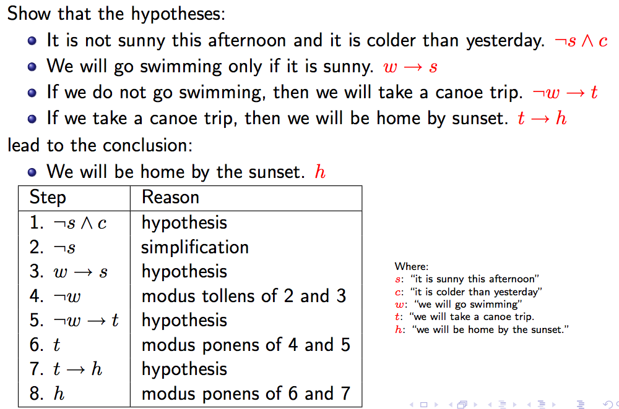
Inference example
http://www.site.uottawa.ca/~lucia/courses/2101-10/lecturenotes/04InferenceRulesProofMethods.pdf
60

Slide 61
Inference example
http://www.site.uottawa.ca/~lucia/courses/2101-10/lecturenotes/04InferenceRulesProofMethods.pdf
⇒
⇒
⇒
61

Slide 62
Inference example
http://www.site.uottawa.ca/~lucia/courses/2101-10/lecturenotes/04InferenceRulesProofMethods.pdf
⇒
⇒
⇒
62

Slide 63
Inference example
http://www.site.uottawa.ca/~lucia/courses/2101-10/lecturenotes/04InferenceRulesProofMethods.pdf
⇒
⇒
⇒
63

Slide 64
Inference example
http://www.site.uottawa.ca/~lucia/courses/2101-10/lecturenotes/04InferenceRulesProofMethods.pdf
⇒
⇒
⇒
⇒
64

Slide 65
Inference example
http://www.site.uottawa.ca/~lucia/courses/2101-10/lecturenotes/04InferenceRulesProofMethods.pdf
⇒
⇒
⇒
α ⇒ β, ¬β
¬α
⇒
65

Slide 66
Inference example
http://www.site.uottawa.ca/~lucia/courses/2101-10/lecturenotes/04InferenceRulesProofMethods.pdf
⇒
⇒
⇒
⇒
⇒
66

Slide 67
Inference example
http://www.site.uottawa.ca/~lucia/courses/2101-10/lecturenotes/04InferenceRulesProofMethods.pdf
⇒
⇒
⇒
α ⇒ β, α
β
⇒
⇒
67

Slide 68
Inference example
http://www.site.uottawa.ca/~lucia/courses/2101-10/lecturenotes/04InferenceRulesProofMethods.pdf
⇒
⇒
⇒
⇒
⇒
⇒
68

Slide 69
Inference example
http://www.site.uottawa.ca/~lucia/courses/2101-10/lecturenotes/04InferenceRulesProofMethods.pdf
⇒
⇒
⇒
α ⇒ β, α
β
⇒
⇒
⇒
69

